Slide 1
Accelerated Stereo Rendering with Hybrid Reprojection-Based Rasterization and Adaptive Ray-Tracing
Authors: Niko Wißmann, Martin Misiak, Arnulph Fuhrmann, and Marc Erich Latoschik
Reporter:
Name: Tianao Wang
ID: 112819772

Slide 2
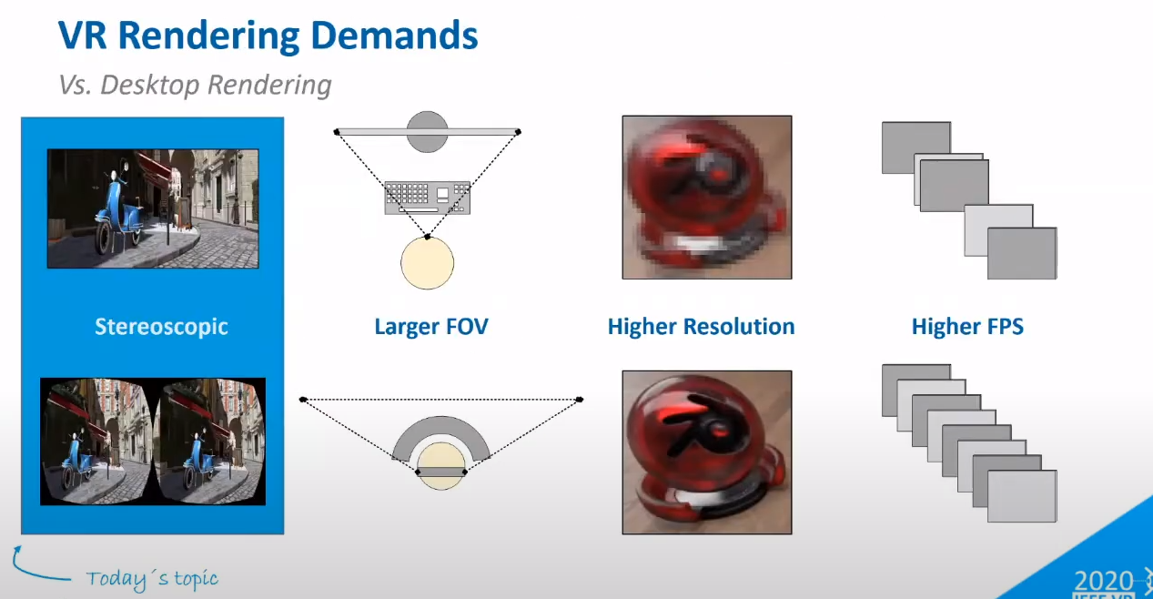

Slide 3
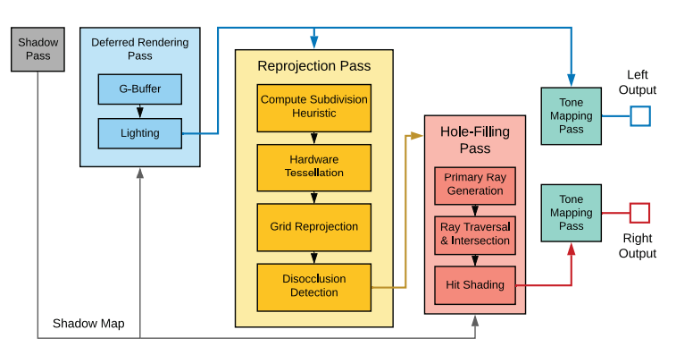
Architecture

Slide 4
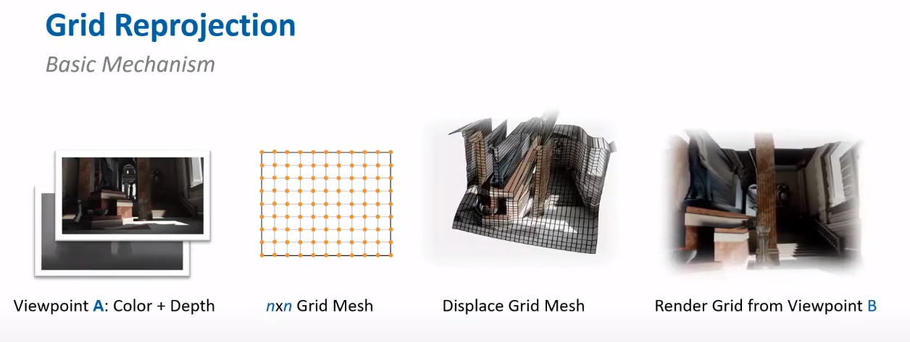

Slide 5
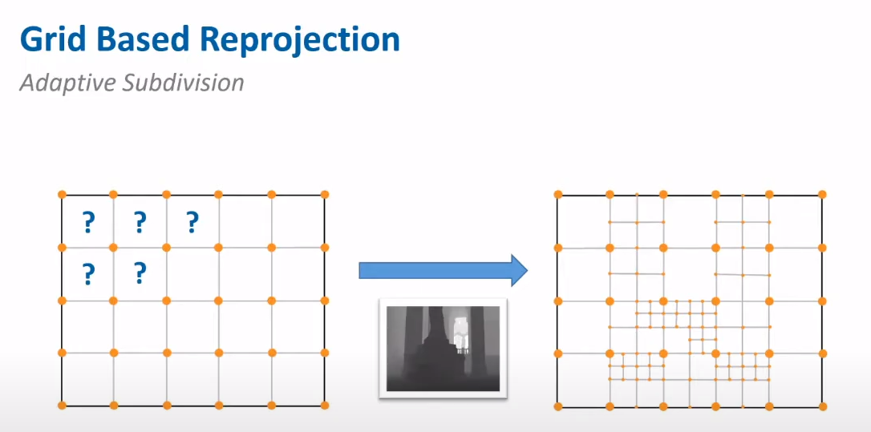

Slide 6
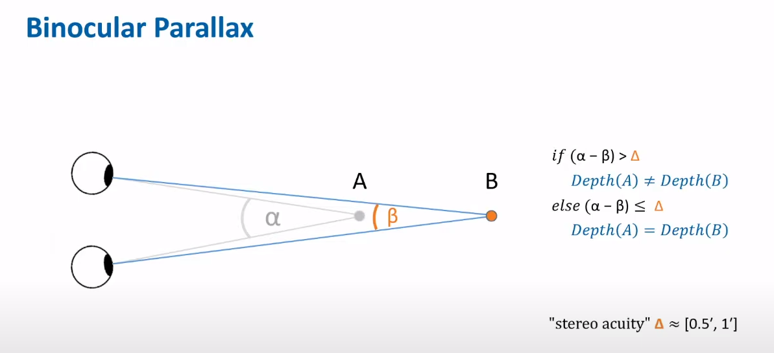

Slide 7
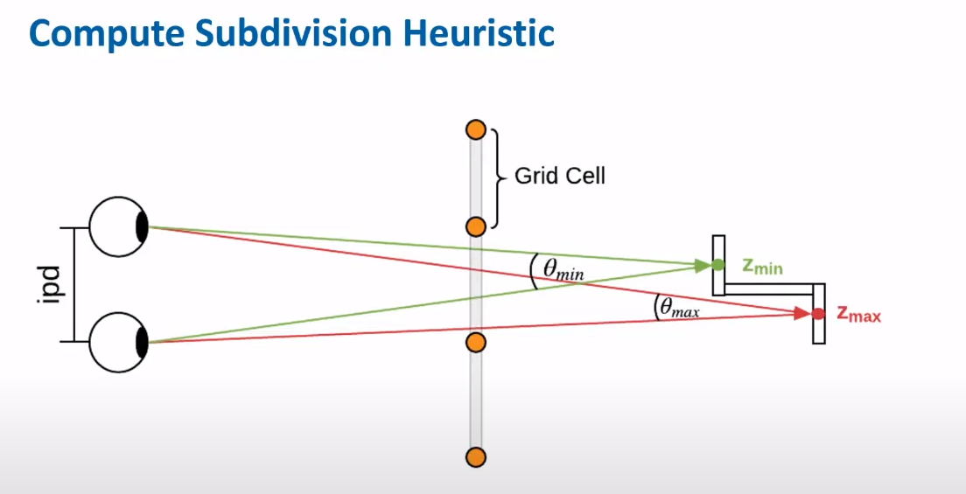

Slide 8
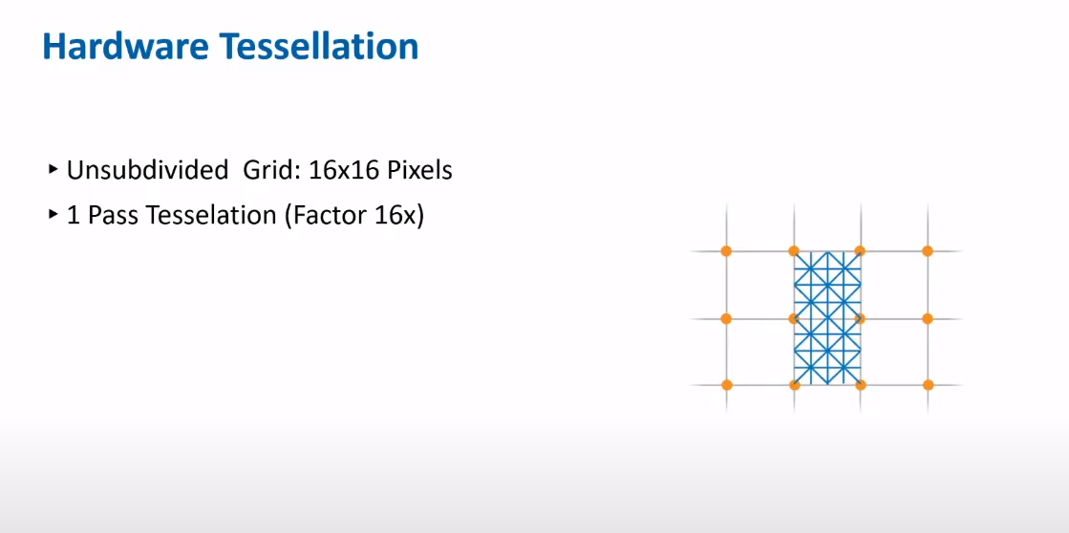

Slide 9
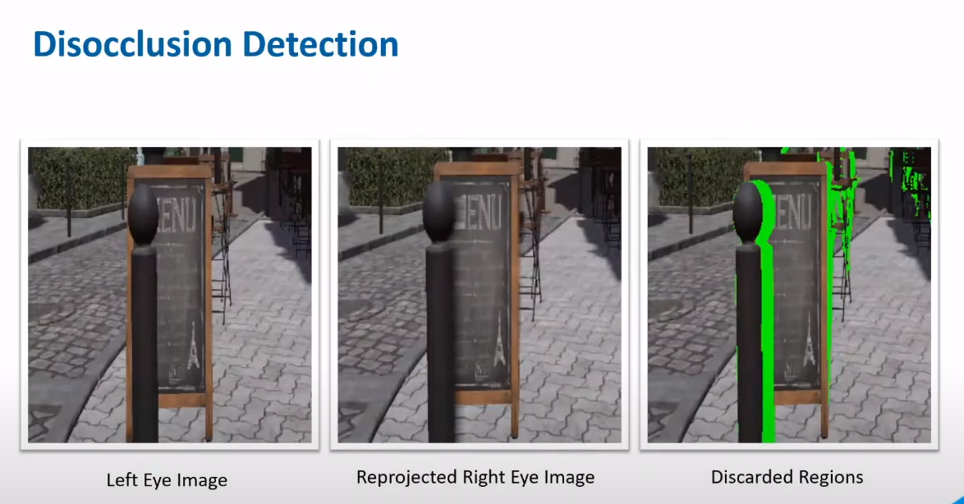

Slide 10
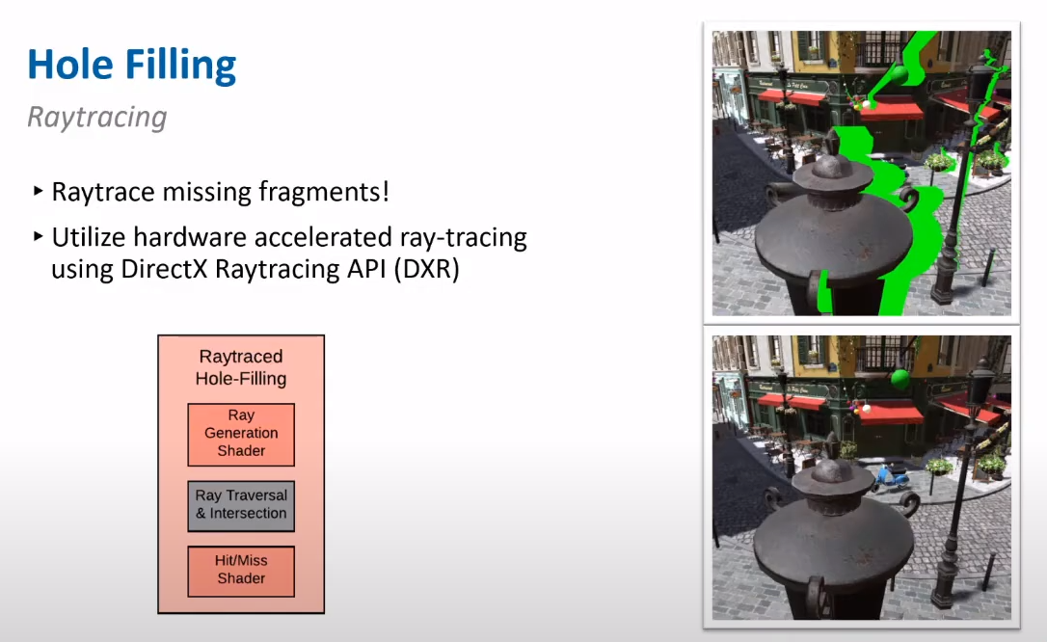

Slide 11
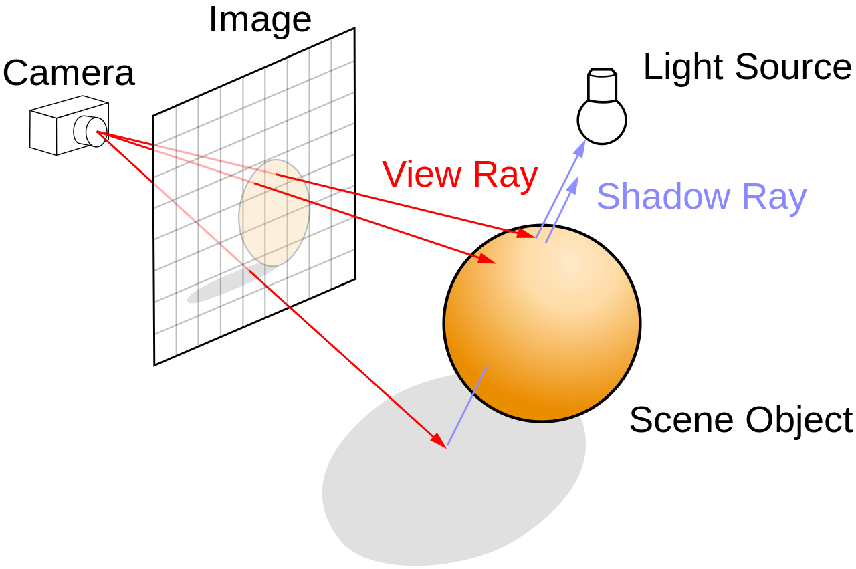

Slide 12
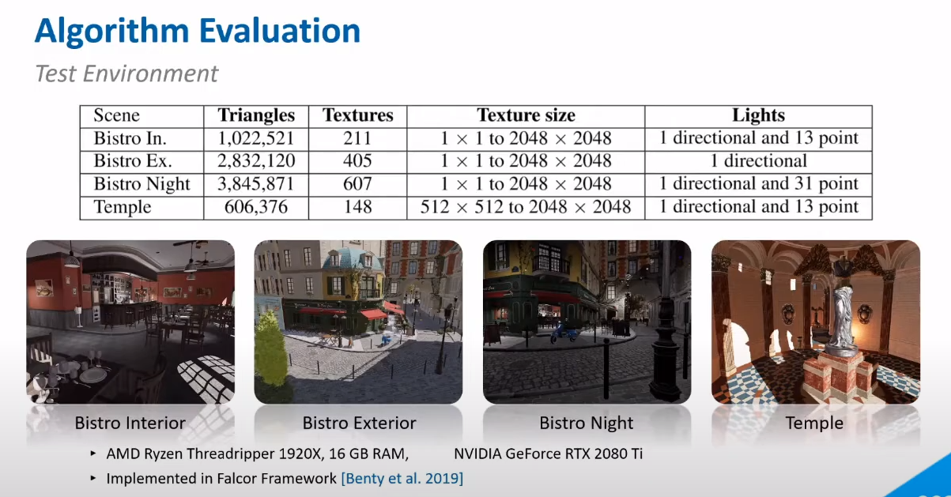

Slide 13
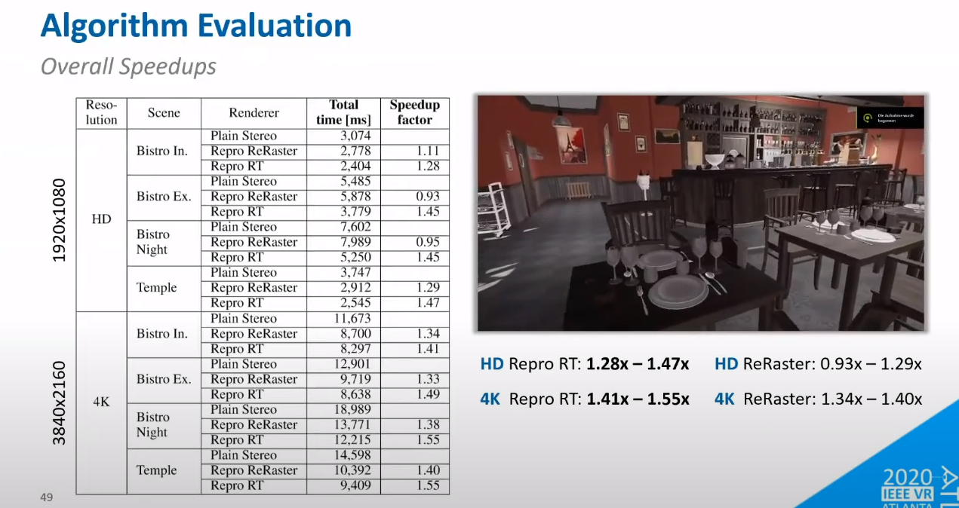

Slide 14
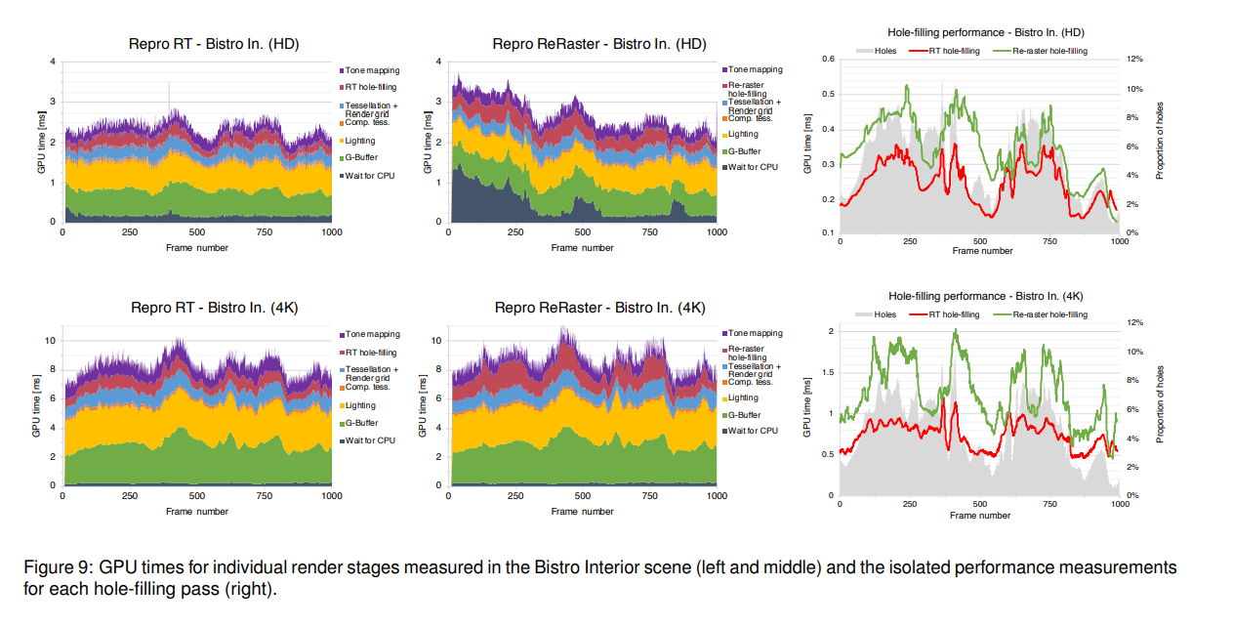

Slide 15
Pros and cons
Pros:
Faster
Independent
Provide a new idea in future
Cons:
Not dynamic
Lose some details
Can’t handle massive disocclusions

Slide 16
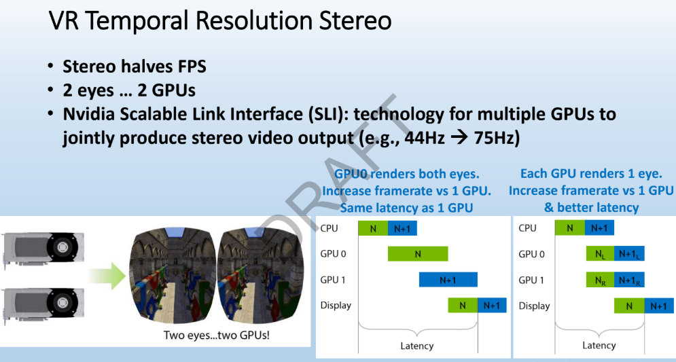
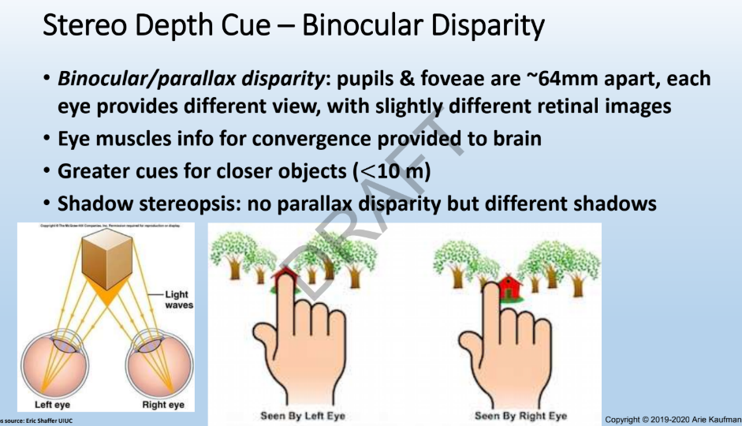

Slide 17
Thank you!

